Slide 1
Real Time Data and Human Happiness?
Amy Nicholson – Technical Evangelist
@AmyKateNicho

Slide 2
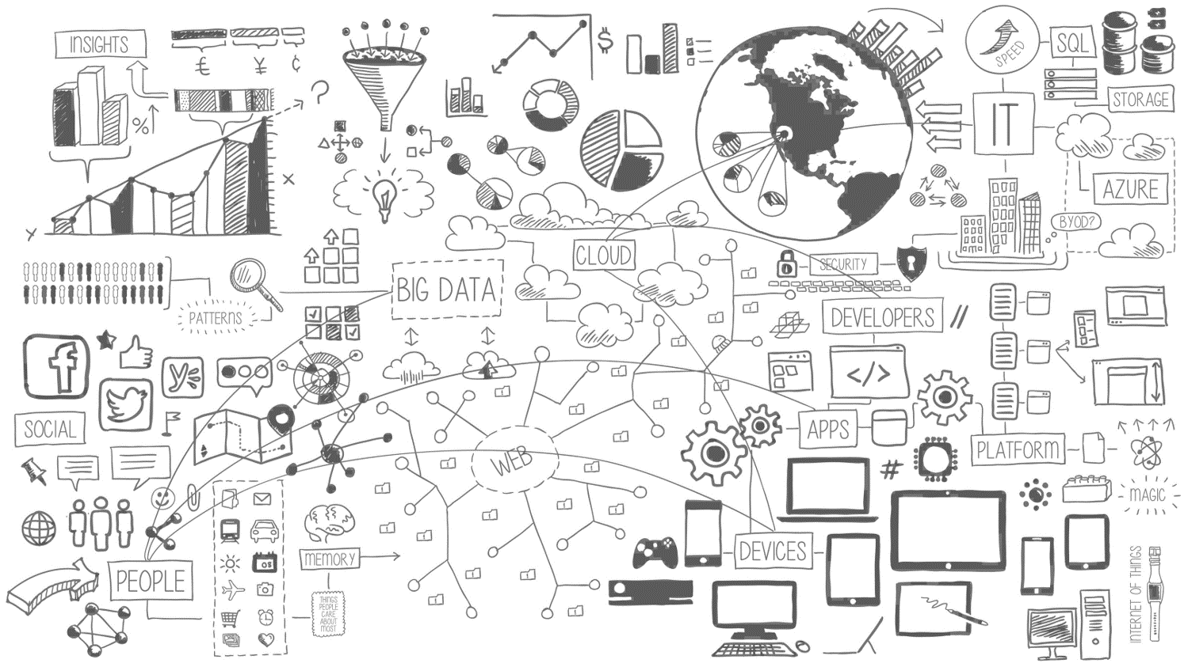

Slide 4
Data evolution
Big data
Legacy systems
Current systems
Advanced analytics
Timely info
Accurate
Thoughtful
OPPORTUNITY $
Notes:
Over the course of time, data is evolving. Legacy systems have evolved into the current systems of today. Systems like As systems change and evolve to become more timely, accurate, and thoughtful greater opportunities for return on system investments are realized. Big Data and Advanced Analytics systems offer superior return-on-investment.

Slide 5
Intelligent action
What happened?
Why did it happen?
What will happen?
What should I do?

Slide 6
Data challenges
VELOCITY, IT’S FAST
VARIETY, IT’S DIFFERENT
VOLUME, IT’S BIG
VERACITY, IT’S UNVERIFIED
Notes:
With the large amounts of data potentially available for analysis, managing data flows efficiently can be a challenge.
Huge amounts of data to process (volume)
A mixture of structured and unstructured data (variety)
New data that’s generated extremely frequently (velocity)
Data quality so that it can be trusted (veracity)

Slide 7
Real-time analytics
Intake millions of events per second
Real-time analytics on continuous streams of data
Detect patterns and anomalies in streaming data
Transform, augment, correlate, temporal operations
Access Information when it is required
Act on this real time data

Slide 8
Real time processing scenarios
Enrich
Analytics
Actions
RETAIN For Future PROCESSING
Telemetry/log processing
Internet of things
Notes:
Key Points:
There are 3 canonical scenarios when we talk about Stream Analytics that categorize the use cases we just looked at.
You can look at these 3 scenarios in different ways: 1) by required human interaction to respond or take an action 2) the response time required to make a decision.
But how does a customer get started with implementing real-time stream processing today?
Talk track:
Enrich: Retain for Future Processing
Large volumes of data coming in and customers don’t necessarily know what they want to do with the data yet but want to retain it for later processing, such as with HDInsight, or as input to develop machine learning models.
Will provide minimal processing such as removing PII information, adding geo-tagging, IP lookup, etc.
Analytics: Telemetry/Log Processing
Next step up the maturity and value curve although there is still a human performing an action, such as monitoring or responding to an alert, with the insight gleaned from the analytics of the real-time data. This is still limited by human response time which isn’t milliseconds and could be in the minutes or hours.
As more data is gathered and processed Machine Learning can also be used to develop and learn from patterns seen in the system such that it is possible to better predict when machines may need to be serviced or when things are about to go wrong.
An example of this scenario is a cloud service that has clusters producing tons of log events (servers), and there is a need to monitor in real-time to resolve the issues faster.
If the same error event comes in from 3 separate streams in a 5 minute window, raise a ticket to resolve the issue before customers report it.
Actions: IoT
We’re talking about the command and control tight loop when talking about IoT. Devices/sensors send data, it is processed, a decision is made, and a command is sent back to the device to control it.
This is up the maturity and value curve again and can produce millisecond response times.
Another example is a vending machine sending inventory and health data. In some cases, the action that needs to be taken may be as simple as rebooting the machine or pushing down a firmware upgrade which can be done without the need for human interaction.
As more data is gathered and processed Machine Learning can also be used to develop and learn from patterns seen in the system such that it is possible to better predict when machines may need to be serviced or when things are about to go wrong.

Slide 9


Real time options in Azure
Apache Storm for HDInsight
Azure Stream Analytics
Apache Spark for HDInsight
Notes:
Hadoop (the "Query" workload): Provides reliable data storage with HDFS, and a simple MapReduce programming model to process and analyze data in parallel.
Apache Spark: A parallel processing framework that supports in-memory processing to boost the performance of big-data analysis applications, Spark works for SQL, streaming data, and machine learning. See Overview: What is Apache Spark in HDInsight?
HBase (the "NoSQL" workload): A NoSQL database built on Hadoop that provides random access and strong consistency for large amounts of unstructured and semi-structured data - potentially billions of rows times millions of columns. See Overview of HBase on HDInsight.
Apache Storm (the "Stream" workload): A distributed, real-time computation system for processing large streams of data fast. Storm is offered as a managed cluster in HDInsight. See Analyze real-time sensor data using Storm and Hadoop.

Slide 10
The Current Level of Human Happiness? Real Time Twitter Data and Sentiment Analysis
@AmyKateNicho

Slide 11






ASA: Twitter Demo Architecture
#welc2017

Slide 12
Build Your Own Real Time Prediction Engine Real Time Azure Machine Learning Models
@AmyKateNicho

Slide 13

ASA: Twitter Demo Architecture
#welc2017
Notes:
Adding in you own Azure machine learning model – directly in Stream Analytics

Slide 14







Cortana Analytics Suite Transform data into intelligent action
Information Management
Big Data Stores
Machine Learning and Analytics
Dashboards and Visualizations
Business apps
Power BI
Azure
Data Lake Analytics
Azure
Data Factory
Azure
Machine Learning
Personal Digital Assistant
Azure
Data Lake Store
Cortana
People
Custom apps
Azure
Data Catalog
Azure
HDInsight (Hadoop)
Perceptual Intelligence
Azure
SQL Data Warehouse
Face, vision
Speech, text
Azure
Event Hub
Azure
Stream Analytics
Business Scenarios
Sensors and devices
Recommendations,
customer churn,
forecasting, etc.
Automated Systems
DATA
INTELLIGENCE
ACTION
Notes:
Cortana Analytics Suite delivers an end-to-end platform with integrated and comprehensive set of tools and services to help you build intelligent applications that let you easily take advantage of Advanced Analytics.
First Cortana Analytics Suite provides services to bring data in, so that you can analyze it. It provides information management capabilities like Azure Data Factory so that you can pull data from any source (relational DB like SQL or non-relational ones like your Hadoop cluster) in an automated and scheduled way, while performing the necessary data transforms (like setting certain data colums as dates vs. currency etc). Think ETL (Extract, Transform, Load) in the cloud. Event hub does the same for IoT type ingestion of data that streams in from lots of end points.
The data brought in then can be persisted in flexible big data storage services like Data Lake and Azure SQL DW.
You can then use a wide range of analytics services from Azure ML to Azure HDInsight to Azure Stream Analytics to analyze the data that are stored in the big data storage. This means you can create analytics services and models specific to your business need (say real time demand forecasting).
The resultant analytics services and models created by taking these steps can then be surfaced as interactive dashboards and visualizations via Power BI
These same analytics services and models created can also be integrated into various different UI (web apps or mobile apps or rich client apps) as well as via integrations with Cortana, so end users can naturally interact with them via speech etc., and so that end users can get proactively be notified by Cortana if the analytics model finds a new anomaly (unusual growth in certain product purchases- in the case of real time demand forecasting example given above) or whatever deserves the attention of the business users.

Slide 15
Thanks for listening
Next Steps…
Sign up for an Azure Free Trial: https://azure.microsoft.com/
Learn more about Azure Stream Analytics and Azure HDInsight services
https://azure.microsoft.com/en-us/services/stream-analytics/
https://azure.microsoft.com/en-gb/documentation/articles/hdinsight-hadoop-introduction/
Investigate the Cortana Analytics Suite: https://www.microsoft.com/en-gb/server-cloud/cortana-analytics-suite/overview.aspx

Slide 16





Thanks for listening
If you want to know more …
amynic@microsoft.com
@AmyKateNicho
www.linkedin.com/in/amykatenicho
http://blogs.technet.com/b/amykatenicho/

